Slide 1
Data Management Planning for grant writing:
Science & Engineering
Library Research Support

Slide 2

What is research data?
Information either created or used as an integral part of research.
Can be born digital or digitised
Data underpins research claims.
May have high re-use value for other researchers.
Notes:
Research data is simply the evidence you have collected or created to underpin your research, and to validate your research claims. You might have created it, scanned it, measured it, photographed, or recorded it, or read and compiled it.
It doesn't include consent forms, websites, project reports, or the administrative data generated during running the project.
It may have value to other researchers because it would be time consuming, costly or impossible to recreate. Even researchers in other disciplines may find the data useful.

Slide 3
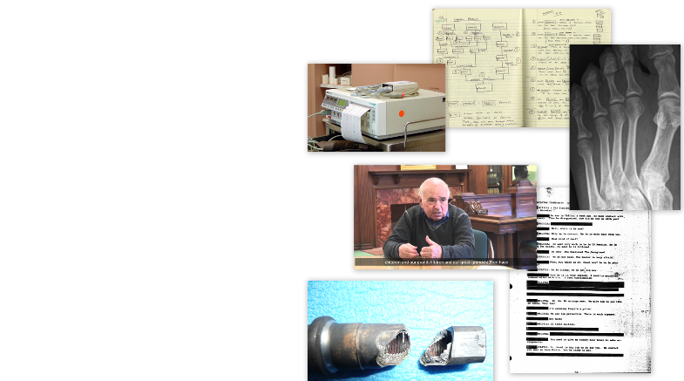
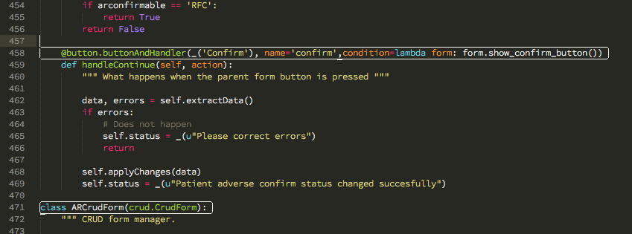
Scan of a lab book
An interview transcript
Database of measurements
Digital photographs or video
New software or code
Online survey results
Notes:
These are some of the types of data you may generate in Science and Engineering. It ranges from scans of lab books or electronic lab books, photographs, x-rays, MRI, or tomography scans, calculations, code, databases of measurements, to audio recording and online interviews, including recorded video.

Slide 4



Research data & grant writing
90% of top funders now mandate research data management
Most ask for a Data Management Plan (DMP) at application which covers: data creation, organisation, documentation, storage, preservation & sharing plans
Check your funder’s data policy before applying
Notes:
The vast majority of funders (and all the big ones) now require some form of a Data Management Plan, usually at the application stage.
Some require an 'outline' plan, which is filled out in greater detail or as a deliverable on the project post-funding, at 6 or 12 months after the project starts. NERC and Horizon 2020 are examples of this.

Slide 5

DMPs usually cover:
What types of data you will generate
  Data package types, number of files, anticipated size
How you will organise & describe your data
  naming conventions, version controls, metadata standards, documentation
How data will be stored and shared & how long data will be maintained
Which data will not be shared & why not, and any period of exclusive use
Notes:
The plan covers the following:
What data you will create:
types eg. 200x interviews in word documents, 3 x calculation in spreadsheets, 1x instrumentation outputs collated in a database, 1000 x X-rays of patients
file types – eg. .docx, .pdf, .xlsx, .jpeg, .tiff and any proprietary software file types - some data may be generated in one file format for working, but converted to an open or less data intensive format for preservation and sharing
Estimated size of the data generated during the project, to calculate total storage
How you will organise it:
How you will set up file naming conventions and routines for saving data
Who will be responsible for day to day management of the data
Use of any metadata standards
Quality control processes
What documentation you will need to understand and replicate or reproduce it:
Additional documentation, protocols, readme.txt files,
documents describing the process for collecting data, calibration of instruments, parameters/inclusions/exclusions in the dataset, and why these decisions were made
How you will store it in the short and long term:
What data will be collected on, and how will it be backed up
When it will be moved to secure networked file storage, such as the RDSF or BRMS
Particularly important when working remotely or in the field
How you will preserve it and share it;
which repository/ies, any code repositories
How long the data will be maintained
Any restrictions
any sensitivities restricting who you can share it with (will it be open, or require some sort of registration before accessing it)
Any data you cannot share
how long you will keep exclusive use of the data after the project ends.
There are slightly different points, word length or templates for each funder, so we’ll look briefly at some in detail.

Slide 6

Engineering and Physical Sciences
Research Council
DMPs aren’t submitted, but EPSRC expects project specific DMPs to exist for all data
Data must be stored appropriately and made available for 10 years from the last date data are accessed
Access to data (including ‘non-digital data’) must be granted
Record of data published online, within 1 year of creation
Any costs (e.g. data managers; additional storage) need to be budgeted for
Published articles to include a 'Data Access Statement' stating where the data can be accessed and under what conditions
Notes:
EPSRC don't require DMPs with research grant applications, but their research data principles include that ‘…project specific data management policies and plans… …should exist for all data’
You will need to write a brief outline DMP at the application stage .
This will be updated to a full DMP if the bid is successful.
Your DMP should contain:
what data you plan to collect or create, including software/code
how you plan to organise, document and store it
any ethical or legal issues around the data and any security measures that need to be taken to protect it
how you plan to preserve and share it in the long term
who will have responsibility for carrying out these tasks and what resources will be required
You must publish a data access statement which points people to where the data can be accessed and under what conditions – open or via a registration - in all published articles and conference proceedings – in fact, if you are claiming funds for Gold open access from URKI, it’s a requirement to access the fund. Funders do monitor compliance with this.

Slide 7

Science and Technology Facilities Council
DMP should be no longer than 2 pages – state what will be generated, and how and where it will be shared
Research data must be made publicly available
Raw data must remain available for 10 years post project
Data which is not re-measurable to be retained ‘in perpetuity’
Data underpinning a publication should be available within 6 months of publication
‘Defined period’ of exclusive data use is permitted, as are resources
Published articles to include a 'Data Access Statement' stating where the data can be accessed and under what conditions
Notes:
STFC has a short DMP of only 2 pages, and they require data to be made available publicly.
They require the DMP to cover
The types of data the project will generate, including raw data, reduced data and published data
How the data will be preserved, and which data will be retained for preservation, and for how long. STFC don’t mind which repository you share data in, as long as it is established, and will maximise its value from aggregation of related data. 10 years is the minimum, but if the data can’t be remeasured, it should be retained in perpetuity
This should include software and metadata you will retain so data can be interpreted
They will allow a defined period of exclusive use, and costing for specialist staff and storage for data

Slide 8

Natural Environment Research Council
Single page ‘Outline Data Management Plan’ (ODMP) required for all grant, post-graduate researcher and fellowship applications
Data to be deposited with an elected NERC data centre
Full DMP required after funding, and within 3 months of project start date
Published articles to include a 'Data Access Statement' stating where the data can be accessed and under what conditions
Notes:
NERC require a single page outline plan at application stage, which should contain between 300 - 500 words. This will be a description of the project, any metadata standards you will use, the types of data you will create, their anticipated size and format, and perhaps a table of the different data packages. You will need to add details on any models, and the nominated NERC data centre. The Outline DMP is used to start a discussion with the nominated data centre, and they will contact PI’s after a grant is awarded to create a full data management plan within 3 months of the start of the grant.

Slide 9

Biotechnology and Biological Sciences
Research Council
Single page DMP required for all grant funding applications
Data must be released at publication of main findings, or in line with best practice in your field
Primary data should be held securely for 10 years after project end
Data to be deposited with an appropriate bioscience repository¹
Published articles to include a 'Data Access Statement' stating where the data can be accessed and under what conditions
¹https://www.ukri.org/councils/bbsrc/facilities-and-resources/find-a-bbsrc-facility-or-resource/#datasharing
Notes:
BBSRC require a one page Data management plan, which should cover the same kinds of things as the previous funders, so
Data areas and data types – the volume, type and content of data that will be generated
Standards and metadata – the standards and methodologies that will be adopted for data collection and management and why these have been selected
Proprietary data – any restrictions on data sharing due to the need to protect proprietary or patentable data
Timeframes – timescales for public release of data
Methods for data sharing – planned mechanisms for making data available through existing public repositories, including access mechanisms where appropriate – BBSRC expect data to be published in an appropriate BioScience repository.

Slide 10
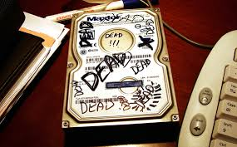
Storing data
Never store valuable/sensitive data on USB drives, Dropbox, MyFiles or any single PC’s hard drive
UoB provide the Research Data Storage Facility (RDSF*). 5TB free per PI, can be shared with collaborators
Other secure storage is fine (e.g. NHS servers, suitable departmental store)
* http://www.bristol.ac.uk/acrc/research-data-storage-facility/
Notes:
When writing your DMP, one of the first things to consider is where you will store your data.
Above all, remember to never store your data, especially if it is valuable or sensitive, on USB drives, Dropbox, MyFiles or any single PC's hard drive.
The University has a specific, safe and secure Research Data Storage Facility, which is backed up nightly to tape, with data stored in 2 secure locations. University PIs are entitled to up to 5TB of storage space, split across their projects. More space is available on disk or tape, at a cost (this will need to be factored into your costings). This storage space also gives you access to the University's Research Data Repository, for publishing (more on that later).
You can give external collaborators access to data at a file level on the RDSF, and you can access it remotely, using the VPN.
Departmental level storage is fine eg. BRMS, NHS servers, but OneDrive is only suitable for very short term/transient research data, and is not suitable for medium to long term storage.
We've got more resources on Storing and working with data on our webpage.

Slide 11
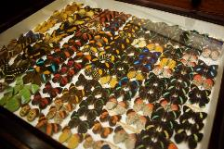
Organising data
Include how files & folders will be named
How versions will be controlled
If producing traditional databases, what the columns and row labels are
See FAIRsharing.org for standards, databases, policies used in your fields
The Research Data Service runs Data Management Training courses, and has a bootcamp and guidance documents on the webpage
Notes:
Decide up front how files and folders will be named, what versioning system you will use for them, how you will file them – your information architecture, and who is responsible for doing this - its day to day management.
Will you store by site? Month? Date? Researcher? This is crucial if you are working collaboratively with others, as then there will be no confusion over what files should be stored where, and who is responsible for overseeing data management. Will there be a lead? Will you share the load equally? Who uploads the final version of a document?
We have an One Minute Guide to file organisation on our webpage on storing data.
If you are creating a database, decide on what the columns and row labels will be before the fields are populated.
FAIRsharing.org provides details on standards – controlled vocabularies, databases, and any associated policies from funders, publishers and repositories.
We have lots of training available we are happy to run these at Faculty, School or Department level, and can also provide bespoke training for research groups. We have an introductory Bootcamp for Research Data Management.

Slide 12


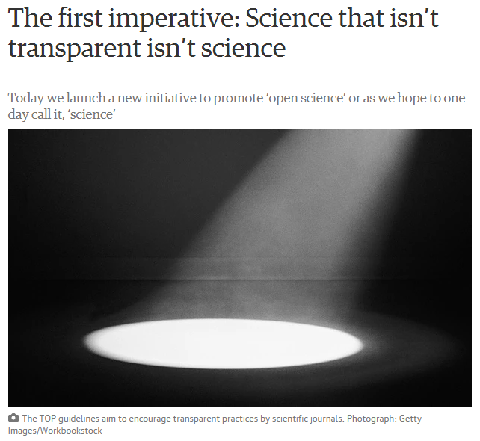
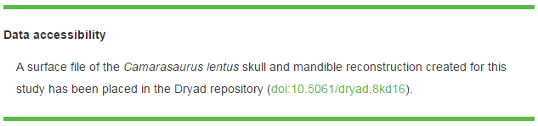
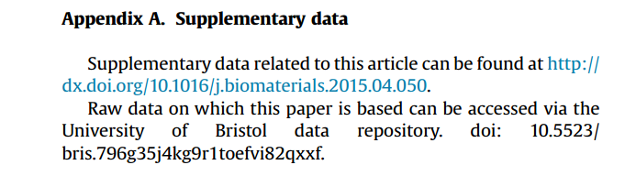
Research data & publishing
Many publishers require research data to be made available & a data access statement included in the article, e.g. Nature, Royal Society, Elsevier & Public Library of Science.
Notes:
The other point in the research lifecycle where you may find there is a requirement to share data is when you come to publish an article. Many publishers now require a dataset DOI for articles at the proofs stage, so it can be added in a template, or in a data access statement. A data access statement details where research data can be accessed and under what conditions, and many funders also require this in published articles, so it is important to remember to practise good research data management throughout your project and to expect your data to be shared at the time research outputs are published.

Slide 13

Open Access Costs
Funders usually require work to be made Open Access
Gold (Paid) Open Access
  Approx £2200 per article
  UKRI and Wellcome Trust provide block grants to the university for Journal Articles
  Otherwise, check with funder to see if these costs should be included in application
Green (Self Archiving) Open Access
  Free
  Upload the Accepted Manuscript to Pure
  Some journals do not have a Green Option - use Gold OA or avoid
Any questions, email lib-research-support@bristol.ac.uk
Notes:
Most funders will have a policy requiring Open Access.
There are two types of Open Access, some journals will offer both, but increasingly it will be one or the other. Both are acceptable to funders.
Gold OA costs money (about £2000), but means the final manuscript will be open access on the publishers webpages.
- Good for high profile papers.
- UKRI funders and Wellcome Trust have provided block grants to the university to pay for these. Authors with these funders should not put journal OA costs in their applications.
- Other funders will have their own rules. Authors should check with them.
Green OA is free, and can be achieved by uploading the Author's Accepted Manuscript to an institutional repository (At Bristol it's done via Pure).
- Some journals only allow Gold OA so check your major journals beforehand.
The Library Research Support team are happy to help. Email lib-research-support@bristol.ac.uk.

Slide 14

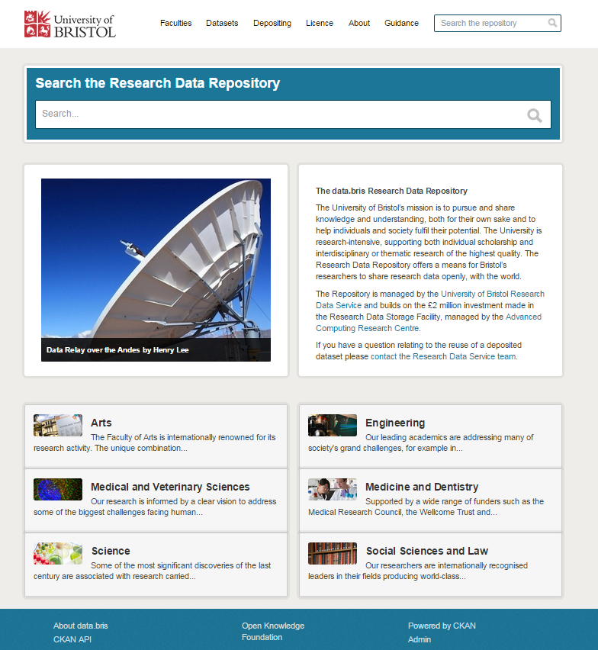
Sharing data
Sharing data with human participants can be challenging
Consent, consent, consent (to SHARE)
If data will be unavailable after study for ethical reasons, say so in DMP
Use a Research Data Repository – eg. UKDS or our own Research Data Repository
  data.bris retains data for minimum 20 years
  provides a stable, citable ‘data DOI’
  offers multiple access control options - (Open, or Restricted/Controlled for bona fide researchers only, subject to registration and approval)
Notes:
Sharing data can with human participants can be be problematic because of sensitivities with anonymity and reidentification however, these are not insurmountable.
Make sure that there is a line in your consent and participant information sheets which clearly states consent to share is being asked for -
'I consent for my data/anonymised data/data stripped of identifiers to be shared openly/with other researchers subject to a data access agreement'.
If you don't have this in your consent forms, there may be issues when you come to share your data, and it will delay or prevent publication. We have some suggested wording in this document Sharing research data concerning human participants, but please do email us to check.
If you can't share the data for ethical reasons, please state this explicitly in your DMP. Many publishers now expect researchers to share underlying data at the point of publishing a paper, so you need to be able to justify the reason why you are unable to do so, and this is a good way to document it.
When you go to share, share it via a data repository, who will provide you with a permanent identifier, often a DOI, which you can link to in your published works, and link from in your dataset record.
You may have a discipline specific repository for data, for example the UK Data Service also https://www.re3data.org/ has a searchable database of repositories.
You can share the data through the University's Research Data Repository, data.bris, where you can share openly or with access controls which limit data access to researchers only, subject to application. Alternatively, you may also use a commercial repository, such as Figshare, Dryad or Zenodo
'On request' is not acceptable to funders – potential data users may be unable to contact researchers as they may have moved institutions, researchers may not have brought data with them, they could have lost the only copy, and they may even be selective about who they share the data with. From a funder's perspective, this is not an appropriate way to preserve the data long term, to make it visible or to share the data widely to maximise returns from public funding.

Slide 15
Key points when planning data management
Use open file formats, especially for sharing and preserving data
Organise data sensibly and provide documentation
Always have at least two copies of data
Use robust networked storage for long-term preservation
Use a repository to share data and obtain a DOI
Consider potential difficulties in sharing and try to overcome these, e.g. appropriate consent, embargoes, copyright issues
Notes:
There are a few key points to remember when planning data management, and these relate to collecting, organising, storing and sharing data
- Use open file formats wherever possible - some data may be generated in one file format for working, but converted to an open and/or less data intensive format for preservation and sharing
- Think carefully about how you will organise your data before you start to collect it – think about the information architecture and folder structure, who will be be able to access and be responsible for adding to and backing up folders before you start
- Always have at least two copies of the data, stored separately. Ideally, you should back up working data whenever changes are made, to a secure filestore and the RDSF, as these offer more security and robust storage
- Share data via a designated data repository, with a DOI
- Explicitly ask your research participants for consent to share – either openly or via controlled access, and consider any copyright issues or potential embargos before data collection begins.

Slide 16
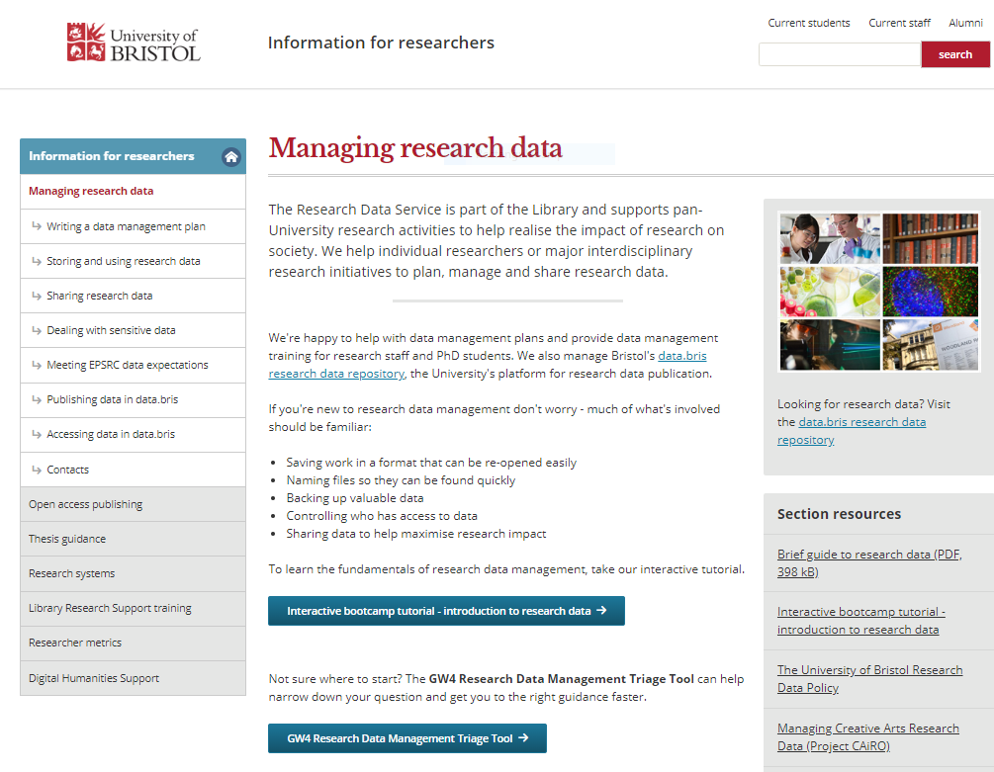
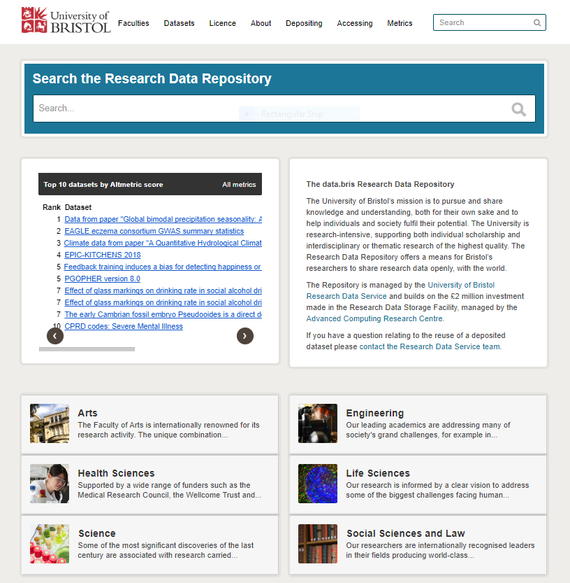
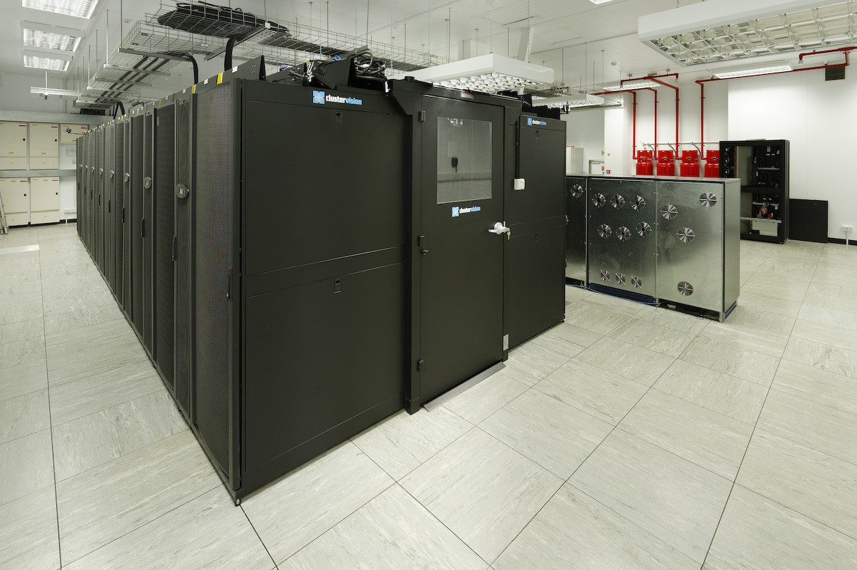
University of Bristol Research Data support
Research Data Service: helpdesk, advice, training, DMP checking (http://bristol.ac.uk/staff/researchers/data/, data-bris@bristol.ac.uk)
Research Data Repository: data publication platform; for sharing open, controlled and restricted data https://data.bris.ac.uk/data/, data-bris@bristol.ac.uk)
Research Data Storage Facility (RDSF): data storage for your project data; for PI’s, project team, and external collaborators (www.acrc.bris.ac.uk/acrc,
hpc-help@bristol.ac.uk )
Notes:
If you need more help about research data management, here are our webpages.
For general help with Research Data Management, training, DMP checking and sharing data, please email us at data-bris@bristol.ac.uk
For data storage and setting up an Research Data Storage Facility account, please contact hpc-help@bristol.ac.uk

